Slide 1

QR CODE

Slide 2
Table of contents
Presention of the QR code
Advantages
How we can use for
Conclusion

Slide 3
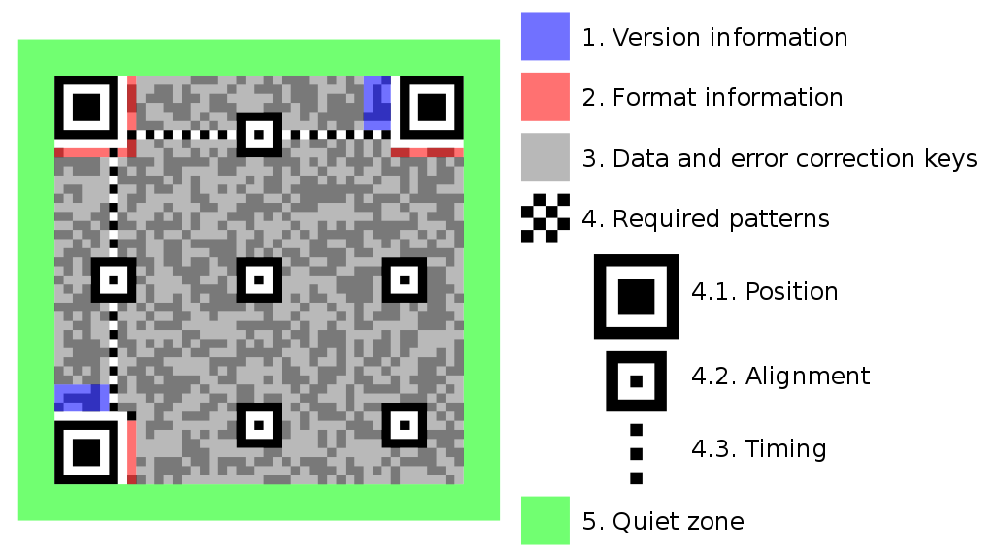
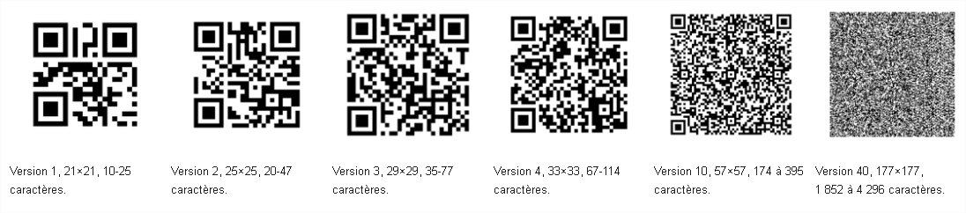
Presentation of the QR CODE
Quick Response Code
Trademark of matrix barcode
By Denso Wave, japanese company 1994
It’s free
First use : to follow the way of etache pieces in fatories of Toyota
7 089 character

Slide 4
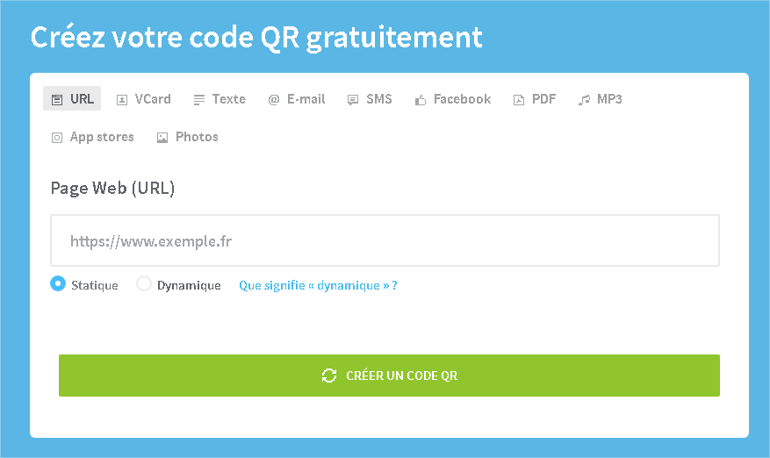
Advantages
Scan with what you want
Fast readability an greater storage capacity
Can share files, website …
Unique
Many combinaison

Slide 5
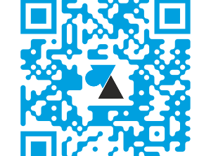
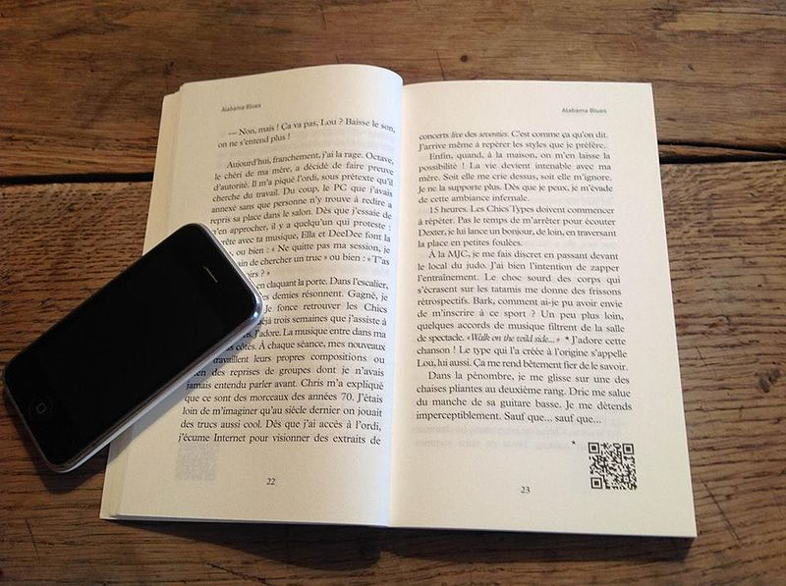
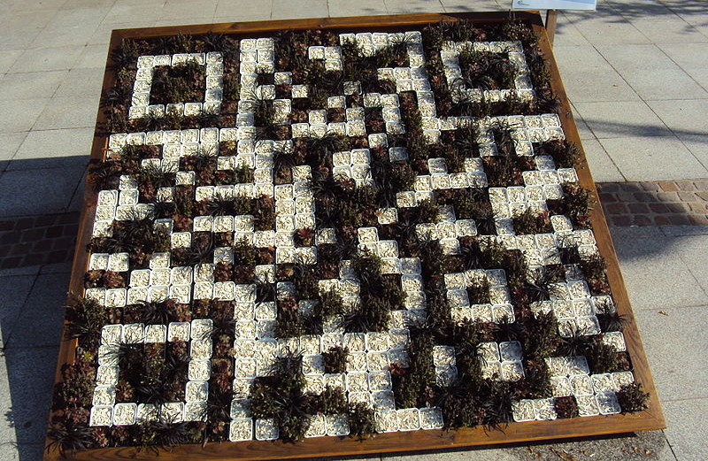
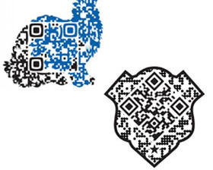
How we can use for
Use in cinema, internet, shop, virtual room….

Slide 6
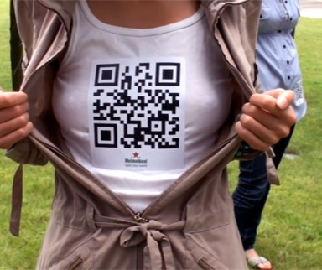
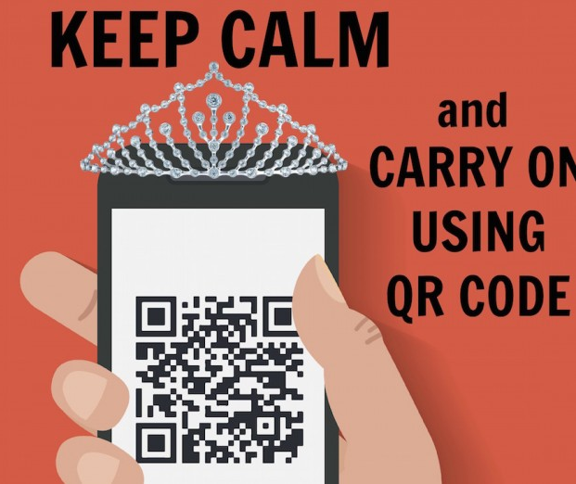
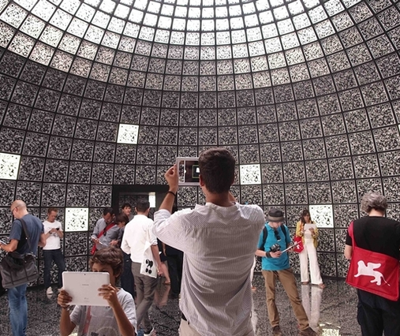
Conclusion
It’s use in all the world
For differents uses
Fast and easy
More and more possibilities
Opinion

